Slide 1
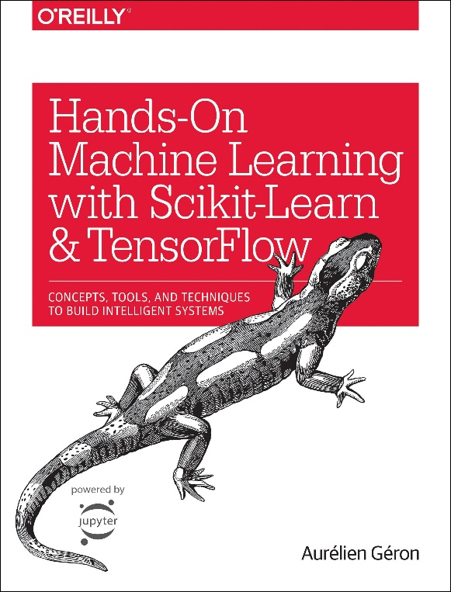
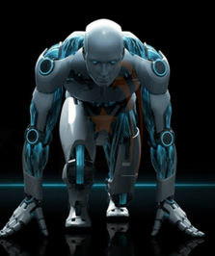
Novice Machine Learning E2E Project
Part 02
Get the Data
Mukunthan Ragavan

Slide 2
E2E Machine Learning Project
Look at the Big picture.
Get the Data.
Discover and visualize the data to get insights.
Prepare the data for ML algorithms.
Select a model to train it.
Fine-tune your model.
Present your solution.
Launch, monitor and maintain your system.

Slide 3
Required installations
Python 3.x version
Jupyter Notebook
Pandas
Matplotlib
Optional: Urllib, tarfile

Slide 4
Get the Data!

Slide 5
Thanks All for watching and your subscription !

